Slide 1



2160710
Distributed Operating System
Unit-2
Communication in Distributed Systems
Prof. Rekha K. Karangiya
9727747317
Rekha.karangiya@darshan.ac.in

Slide 2
Topics to be covered
Computer Network and Layered Protocols
Message Passing and Related Issues
Synchronization
Client Server Model & its Implementation
Remote Procedure Call and Implementation Issues
Case Studies: SUN RPC, DEC RPC

Slide 3
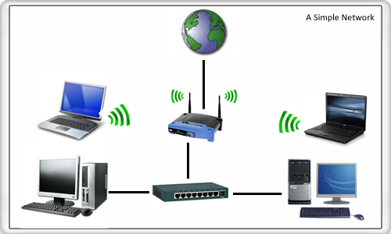
Computer Network
A computer network or data network is a telecommunications network which allows computers to exchange data.
In computer networks, networked computing devices exchange data with each other using a data link.
The connections between nodes are established using either cable media or wireless media.
The best-known computer network is the Internet.
Wireless
Wired

Slide 4
Computer Network in DOS
A Distributed System is basically a computer network whose nodes have their own local memory and may also have other hardware and software resources.
A Distributed System relies on the underlying computer network for the communication of data and control the information between nodes.
The performance and reliability of a Distributed system depends on the underlying computer network.

Slide 5
Classification of Network
Network types depends on how large they are and how much of an area they cover geographically.
Networks are classified based on
Size
Capabilities
Geographical distance

Slide 6
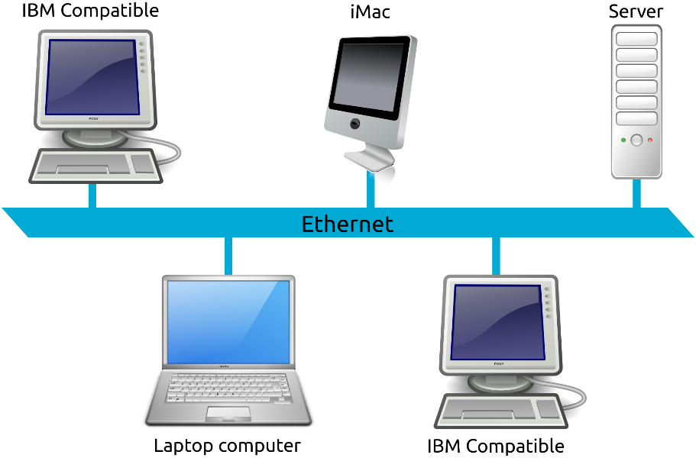
Local Area Network(LAN)
A group of devices(computers, servers, switches, and printers) that are located in the same building.

Slide 7
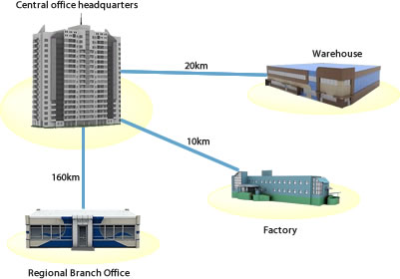
Metropolitan Area Network(MAN)
Larger than LAN.
Spans over several buildings in a city or town.

Slide 8
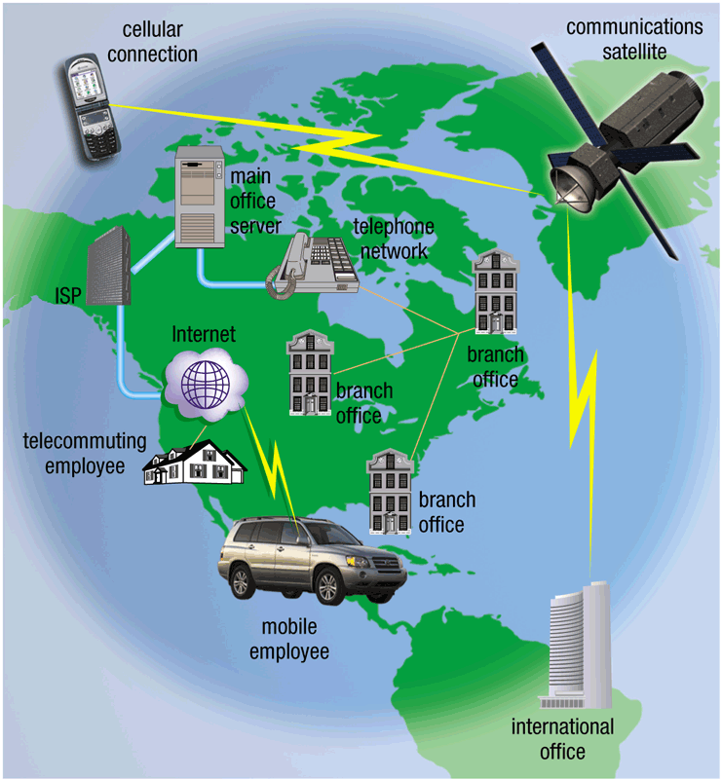
Wide Area Network(WAN)
Largest type of network.
Spans over large geographic area (e.g., country).
The internet is example of WAN.

Slide 9
Classification of Network
Basis of Comparison | LAN | MAN | WAN
Expands to | Local Area Network | Metropolitan Area Network | Wide Area Network
Meaning | A network that connects a group of computers in a small geographical area. | It covers relatively large region such as cities, towns. | It spans large locality & connects countries together.
Ownership of Network | Private | Private or Public | Private or Public
Design and Maintenance | Easy | Difficult | Difficult
Propagation Delay | Short | Moderate | Long
Speed | High | Moderate | Low

Slide 10
Classification of Network
Basis of Comparison | LAN | MAN | WAN
Equipment Needed | Switch, Hub | Modem, Router | Microwave, Radio Transmitters & Receivers
Range(Approx.) | 1 to 10 km | In 100 km | Beyond 100 km
Used for | College, School, Hospital | Small towns, City | Country/Continent

Slide 11
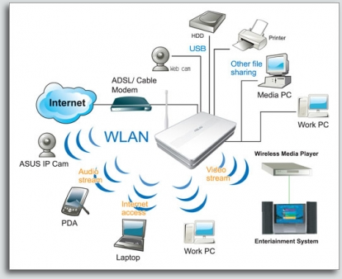
Wireless Network
A wireless LAN uses wireless transmission medium.
Wireless Network used to have
high prices
low data rates
licensing requirements
Popularity of wireless LANs has grown rapidly.

Slide 12



The Problem of Communication
LAN
How these two computers are going to communicate with each other?
In order to accomplish successful communication between computers or network of different architectures, 7-layered OSI model was introduced.

Slide 13
Layered Protocols - OSI Model
OSI is “ Open Systems Interconnection".
It outlines What needs to be done to send data from one computer to another, Not How it should be done.
A layered protocol architecture provides a conceptual framework for dividing the complex task into simpler tasks of exchanging information between remote hosts.
Each protocol layer has a narrowly defined responsibility.
A protocol layer provides a standard interface to the next higher protocol layer.

Slide 14
OSI Model
APPLICATION
Application to Application
APPLICATION
HIGHER LAYER
PRESENTATION
Application to Application
PRESENTATION
SESSION
Application to Application
SESSION
TRANSPORT
Process to Process
TRANSPORT
MIDDLE LAYER
NETWORK
Source to Destination
Router
NETWORK
Source to Destination
DATA LINK
Hop to Hop
Switch
DATA LINK
LOWER LAYER
Hop to Hop
PHYSICAL
Hub and Repeater
PHYSICAL
Physical Medium

Slide 15
OSI Model
Application Layer
Application layer is used by Network applications.
Example: browsers
Data
Compression
Translation
Encryption
Presentation Layer
EDB12345AB
1010110010
10110100
01010101
Session Management – Securing multiple requests to a service from the same user.
Authentication - Who you are?
Authorization - Rules that determine who is allowed to do what.
Decryption
Session Layer
Segmentation: Received data divided into small data units called segments.
Flow control: It controls amount of data being transmitted.
Error Control: It is the process of detecting and correcting corrupted segments.
Transport Layer
Logical addressing
Routing
Path determination
Network Layer
Physical addressing
Media access control
Error correction
Data Link Layer
Physical Layer

Slide 16
OSI Model (Layers & Activities)
OSI Layers
Activities
Application
To allow access to network resources.
Presentation
To translate, compress, and encrypt/decrypt data.
Session
To establish, manage, and terminate session.
Transport
To provide reliable process-to-process
message delivery and error recovery.
Network
To move packets from source to destination;
To provide internetworking.
Data Link
To organize bits into frames;
To provide hop-to-hop delivery.
Physical
To transmit bits over a medium;
To provide mechanical and electrical specifications.

Slide 17
TCP/IP Reference Model
Simple Network Management Protocol
Collecting information from, and configuring network devices, such as servers, printers, hubs, switches
User Datagram Protocol
Connectionless
Sending data without establishing connection
Transmission Control Protocol
Connection oriented
Connection established before sending data
Hypertext Transfer Protocol
Browser and web server communication
Simple Mail Transfer Protocol
Send and Receive mail messages
File Transfer Protocol
Transfer Computer files between a client and server
The name stands for “teletype network”
Remote login protocol
Layer
Protocols
Application
HTTP
TELNET
FTP
SMTP
SNMP
Transport
TCP
UDP
Internet
IP
ICMP
Network Access (Host-to-network)
ETHERNET
PACKET RADIO
Internet Protocol
A set of rules governing the format of data sent over the Internet or other network.
Internet Control Message Protocol
Used by network devices, like routers, to send error messages and operational information
Network protocol that controls how data is transmitted over a LAN
Protocol of broadcasting that makes use of radio signals carrying packets of data.

Slide 18
The Evolution of ATM
ATM is “Asynchronous Transfer Mode”
Two types of networks:
Telephone networks, which were (and still are) primarily used to carry real-time voice, and data networks, which were primarily used to transfer text files.
It was therefore natural to design a networking technology that would be appropriate for transporting real-time audio and video as well as text, e-mail, and image files.
Asynchronous transfer mode (ATM) achieved this goal.

Slide 19
ATM technology is capable of carrying a wide range of information transfers, from e-mail to videoconferences, with a range of quality of service that can match user needs. Thus, ATM could provide the full range of services contemplated as offerings on the information superhighway.
Asynchronous Transfer Mode (ATM) was designed as a single unified networking standard that could support both circuit-switched networking and packet-based networking.

Slide 20
ATM was a significant step in the convergence of real-time and nonreal-time applications on a single communications infrastructure. ATM was the first protocol suite to enable true differentiation of traffic classes and certainly set the standards by which subsequent technologies are measured. In fact, the ATM approach to QoS is the foundation for much of the mechanisms and terminology used in IP-based, QoS-aware networks of the modern era.

Slide 21
ATM is a virtual circuit-based technology through which a connection is established between the two endpoints before the data exchange begins. The term asynchronous refers to the switching of cells, whereas the bit stream that carries the cell is actually synchronous. Asynchronous, in the context of ATM, means that sources are not limited to sending data (or cells) during a set timeslot, which is the case with circuit switching, a truly synchronous technology

Slide 22
Packet-switched vs Circuit-switched
Packet-switched networks move data in separate, small blocks -- packets -- based on the destination address in each packet. When received, packets are reassembled in the proper sequence to make up the message. Circuit-switched networks require dedicated point-to-point connections during calls.
Circuit-switched networks and packet-switched networks have traditionally occupied different spaces within corporations. Circuit-switched networks were used for phone calls and packet-switched networks handled data. But because of the reach of phone lines and the efficiency and low cost of data networks, the two technologies have shared chores for years.

Slide 23
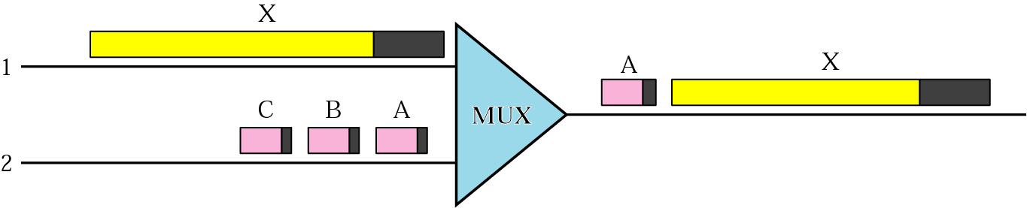
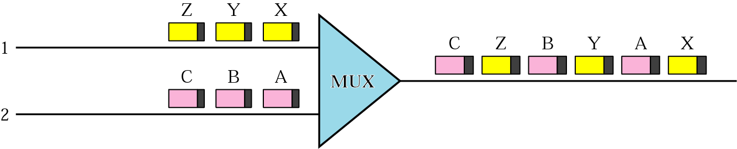
The Evolution of ATM
The variety of packet sizes makes traffic unpredictable.
A cell network uses the cell as the basic unit of data exchange.
A cell is defined as a small, fixed sized block of information.
Mixed Network Traffic
Cell Network

Slide 24
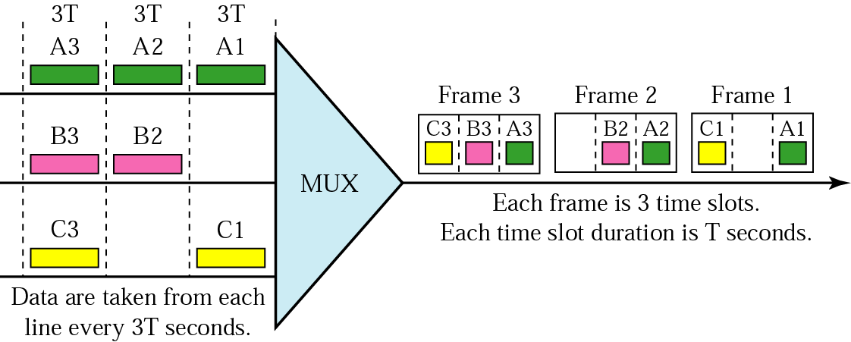
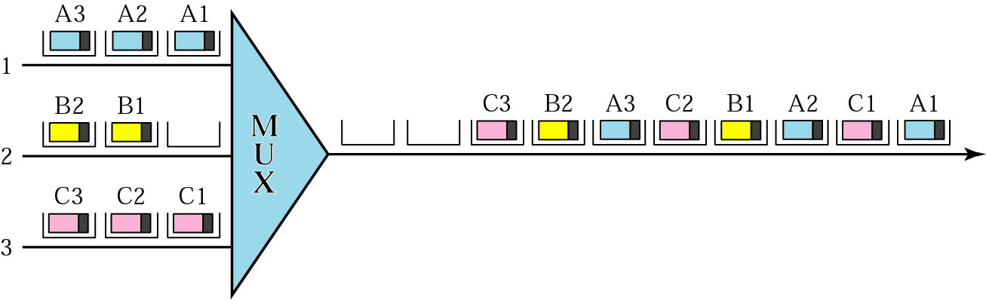
Synchronous vs. Asynchronous TDM

Slide 25
ATM Reference Model
ATM uses asynchronous TDM.
ATM is a connection-oriented, high-speed, low-delay switching and transmission technology that uses short and fixed-size packets(called cells) to transport information.
ATM uses packet switching with fixed-length packets of 53 bytes. In ATM , these packets are called cells. Each cell has five bytes of header and 48 bytes of “payload.”

Slide 26
ATM Reference Model
Management plane
Plane management
Control plane
User plane
Layer management
Higher layers
Higher layers
The lowest layer in the ATM protocol.
It describes the physical transmission media.
We can use shielded and unshielded twisted pair, coaxial cable, and fiber-optic cable.
ATM adaptation layer
It performs all functions relating to the routing and multiplexing of cells over Virtual Channels.
It generates a header to the segment streams generated by the ATM Adaptation Layer(AAL).
Convert data from upper-layer into 48-byte data units for the ATM cells.
Disassembly/reassembly of these packets.
ATM layer
Physical layer

Slide 27
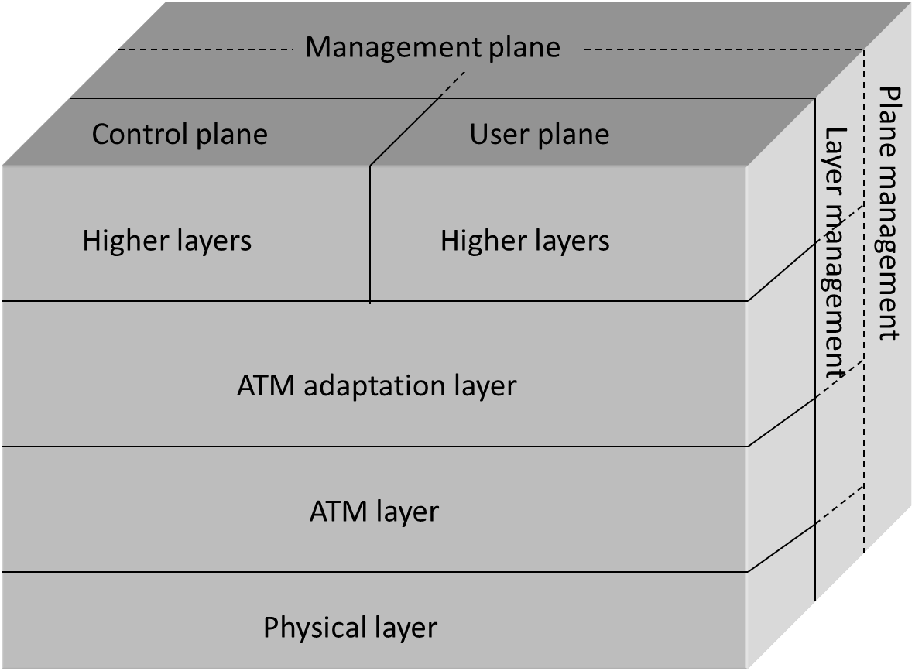
ATM Reference Model
OSI Stack
ATM Reference Model
Application Layer
Presentation Layer
Session Layer
Transport Layer
Network Layer
Data Link Layer
Physical Layer

Slide 28
Main Features of ATM Technology
International standard-based technology (for interoperability).
Low network latency (for voice, video, and real-time applications).
Low variance of delay (for voice and video transmission).
Guaranteed quality of service.
High capacity switching (multi-giga bits per second).
Bandwidth flexibility (dynamically assigned to users).
Scalability (capacity may be increased on demand).
Medium not shared for ATM LAN (no degradation in performance as traffic load or number of users increases).
Supports audio, video, imagery, and data traffic (for integrated services).

Slide 29
Message Passing System
Message is a block of Information.
Message passing is a basic form of Inter process communication used in distributed systems.
In massage passing model, communication takes place by means of messages exchanged between the cooperating processes.
P1
Send
P2
Receive
The Message Passing Approach

Slide 30
Desirable Features of a Good Message Passing System
Simplicity : A message passing system should be simple and easy to use. It should be possible to communicate with old and new applications, with different modules without the need to worry about the system and network aspects.
Uniform Semantics :
Local communication
Remote communication
Semantics of Remote communication should be as close as possible to those of local communications.
Efficiency : Less number of message exchanges, as far as practicable, during the communication process.

Slide 31
Desirable Features of a Good Message Passing System
Reliability : Reliable IPC protocol can cope with failure problem and guarantees the delivery of messages.
Handling of lost messages.
Handling of duplicate messages
Correctness : Required for Group Communication.
Atomicity
Ordered delivery
survivability
Flexibility : It must have flexibility to permit any kind of control flow between the cooperating processes, including synchronous and asynchronous send/receive.

Slide 32
Desirable Features of a Good Message Passing System
Security : Capable of providing a secure end-to-end communication. It includes as follows:
Authentication of the receiver(s) of message by the sender.
Authentication of the sender of a message by its receiver(s).
Encryption of a message before sending it over the network.
Portability : It should be possible to easily construct a new IPC facility on another system by reusing the basic design of the existing message passing system.

Slide 33
INTER PROCESS COMMUNICATION
The most popular form of interprocess communication involves message passing. Processes communicate with each other by exchanging messages. A process may send information to a port, from which another process may receive information.
Inter process communication (IPC) is used for exchanging data between multiple threads in one or more processes or programs.
Interprocess Communication is a process of exchanging the data between two or more independent process in a distributed environment is called as Interprocess communication. Interprocess communication on the internet provides both Datagram and stream communication

Slide 34
Issues in IPC by Message Passing
In the design of IPC protocol for a message passing system, the following important issues need to be considered:
Who is the sender?
Who is the receiver?
Is there one receiver or many receivers?
Is the message guaranteed to have been accepted by its receiver(s)?
Does the sender need to wait for reply?

Slide 35
Issues in IPC by Message Passing
What should be done if the catastrophic event such as a node crash or a communication link failure occurs during the course of communication?
What should be done if the receiver is not ready to accept the message: will the message be discarded or stored in buffer?
If there are several outstanding messages for a receiver, can it choose the order in which to service the outstanding messages.

Slide 36
Synchronization in Message Passing
The central issue in the communication structure is the synchronization.
Communication between two processes takes place through calls to send() and receive() primitives.
Message passing may be either blocking or nonblocking- also known as synchronous and asynchronous.
A primitive is said to have nonblocking semantics if its invocation does not block the execution of its invoker: otherwise a primitive is said to be blocking type.

Slide 37
Synchronization in Message Passing
Blocking send primitive: Sending process blocked until it receives acknowledgement.
Nonblocking send primitive: Sending process is allowed to proceed with its execution.
Blocking Receive primitive: Receiving process blocked until it receives a message.
Nonblocking Receive primitive: Receiving process is allowed to proceed with its execution after execution of the receive statement.
Senders execution
Receivers execution
Receive(Message) Execution suspended
Send(Message) Execution suspended
Message
Execution resumed
Acknowledgement
Send
Execution resumed
Executing State
Blocked State

Slide 38
Buffering
Null Buffer (Zero capacity):
The queue has maximum length of zero; thus, the link cannot have any messages waiting in it.
In this case, the sender must block until the recipient receives the message.
Sending process
Receiving process
Message

Slide 39
Buffering
Single-message buffer:
The queue has maximum length of one; thus, the link have one message waiting in it.
The main idea behind the single-message buffer strategy is to keep the message ready for use at the location of the receiver.
Sending process
Receiving process
Message
Single-message buffer

Slide 40
Buffering
Finite buffer(Bounded capacity):
The queue has finite length n; thus at most n messages reside in it.
If the queue is not full when a new message is sent, the message is placed in the queue and the sender can continue execution without waiting.
If the link is full, the sender must block until space is available in the queue.

Slide 41
Buffering
Sending process
Receiving process
Message
Multiple-message buffer

Slide 42
Buffering
Unbounded-capacity buffer:
The queue length is potentially infinite; thus any number of messages can wait in it.
The sender never blocks.

Slide 43
Failure in IPC
Loss of Request Message:
client
server
Request message
Send request
Lost
Loss of Response message:
client
Request message
server
Successfully Request Execution
Response
Send Response
Lost

Slide 44
Failure in IPC
Receiver’s computer crash:
client
server
Request message
Send request
Unsuccessfully Request Execution
Crash
Restarted

Slide 45
Failure Handling in IPC
client
Request message
server
Send request
Time out
Retransmit Request Message
Send request
Lost
Unsuccessfully Request Execution
Time out
Crash
Send request
Restarted
Retransmit Request Message
Time out
Response
Successful Request Execution
Lost
Retransmit Request Message
Send request
Successful Request Execution
Response

Slide 46
Failure Handling in IPC
Server
Balance=1000
client
Send request
Request
Debit 100
Process debit routine
Balance=1000-100=900
Time out
Response
Return (success, 900)
Lost
Send request
Retransmit request
Debit 100
Process debit routine
Balance=900-100=800
Return (success, 800)
Response
Which is not correct
Received
balance=800
(success, 800)

Slide 47
Failure Handling in IPC
Server
Balance=1000
Request identifier | Reply to be sent
client
Request-1 | (success, 900)
Send request-1
Request
Debit 100
Check reply cache for request-1
No match found, so process request-1
Save reply
Time out
Response
Return (success, 900)
(success, 900)
Lost
Send request-1
Retransmit request-1
Debit 100
Check reply cache for request-1
Match found
Extract match
Return (success, 900)
Response
Received
balance=900
(success, 900)

Slide 48
Four-Message Reliable IPC Protocol
The client sends a request message to the server.
When the request message is received, it returns an acknowledgment message to the client machine.
When the server finishes processing the client’s request it returns a reply message (containing the result of processing) to the client.
When the reply is received at client machine, it returns an acknowledgment message server machine.
Client
Server
Request
Acknowledgment
Reply
Acknowledgement
Executing State
Blocked State

Slide 49
Three-Message Reliable IPC Protocol
The client sends a request message to the server.
When the server finishes processing the client’s request, it returns a reply message (containing the result of processing) to the client. The client remains blocked until the reply is received.
When the reply message is received at the client’s machine, it returns an acknowledgment message.
Client
Server
Request
Reply
Acknowledgement
Executing State
Blocked State

Slide 50
Two-Message Reliable IPC Protocol
The client sends a request message to the server and remains blocked until a reply is received from the server.
When the server finishes processing the client’s request, it returns a reply message (containing the result of processing) to the client.
If the reply is not received within the timeout period, the kernel of the client machine retransmits the request message.
Client
Server
Request
Reply
Executing State
Blocked State

Slide 51

Client Server Model
Clients: Request servers for the completion of a task.
Generally called desktop PCs or workstations.
Servers: Receive requests from the clients and process them.
After the processing is complete, the servers send a reply to the clients who sent the request.
File Server
Client-1
Client-2
Request
Network
Reply

Slide 52
Client Server Model
A machine can run as single/multiple clients or single/multiple servers, or a mix of both.
This model uses the connectionless Request Reply protocol thus reducing the overhead of the connection oriented TCP/IP or OSI protocol.
7
Request
6
Client
Server
5
Request/reply
Reply
4
Kernel
Kernel
3
2
Data Link
1
Physical
Network

Slide 53
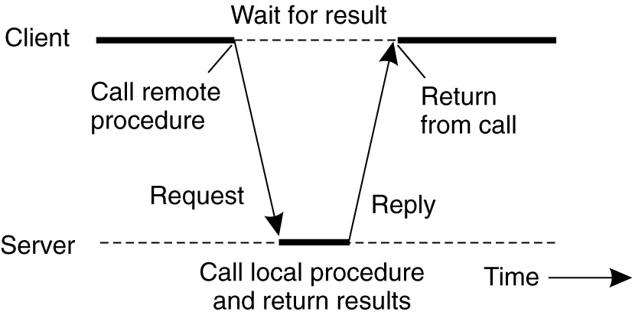
Client Server Model
The Request Reply protocol works as follows:
The client requesting the service sends a request message to the server.
The server completes the task and returns the result indicating that it has performed.
The Request Reply protocol defines the set of request and replies to the corresponding requests.

Slide 54
Client Server Model
Following are different types of packets transmitted across the network.
REQ: Request packet is used to send the request from the client to the server.
Reply: This message is used to carry the result from the server to the client.
ACK: Acknowledgement packet is used to send the correct receipt of the packet to the sender.
Are You Alive (AYA)?: This packet is sent in case the server takes a long time to complete the client's request.
I am Alive (IAA): The server, if active, replies with this packet.

Slide 55
Client Server Model Interaction
Two processes in client-server model can interact in various ways:
Sockets
Remote Procedure Calls (RPC)
Socket
The process acting as server opens a socket using a well-known port and waits until some client request comes.
The second process acting as a client also opens a socket but instead of waiting for an incoming request, the client processes ‘requests first’.
Server Program
Client Program
Socket
Socket
Transport
Transport
Network
Network
Data link
Data link
Physical
Physical

Slide 56
Remote Procedure Call
Remote Procedure Call (RPC) is a protocol that one program can use to request a service from a program located in another computer on a network without having to understand the network's details.
A procedure call is also sometimes known as a function call or a subroutine call.
RPC uses the client-server model.

Slide 57
RPC Model
It is similar to commonly used procedure call model. It works in the following manner:
For making a procedure call, the caller places arguments to the procedure in some well specified location.
Control is then transferred to the sequence of instructions that constitutes the body of the procedure.
The procedure body is executed in a newly created execution environment that includes copies of the arguments given in the calling instruction.
After the procedure execution is over, control returns to the calling point, returning a result.

Slide 58
Remote Procedure Calls Vs Local Procedure Calls
Unlike local procedure calls, with remote procedure calls,
Disjoint Address Space.
Absence of shared memory.
Meaningless making call by reference, using addresses in arguments and pointers.
RPC’s are more vulnerable to failure because of:
Possibility of processor crashes or
communication problems of a network.
RPC’s are much more time consuming than LPC’s due to the involvement of communication network.

Slide 59
Functions of RPC Elements
The Client
It is user process which initiates a remote procedure call
The client makes a perfectly normal call that invokes a corresponding procedure in the client stub.
The Client stub
On receipt of a request it packs a requirements into a message and asks the local RPCRuntime to send it to the server stub.
On receipt of a result it unpacks the result and passes it to client.
RPCRuntime
It handles transmission of messages between client and server.

Slide 60
Functions of RPC Elements
It is responsible for
Retransmission,
Acknowledgement,
Routing and Encryption.
The Server stub
It unpacks a call request and make a perfectly normal call to invoke the appropriate procedure in the server.
On receipt of a result of procedure execution it packs the result and asks to RPCRuntime to send.
The Server
It executes a appropriate procedure and returns the result from a server stub.

Slide 61
RPC Mechanism
Client Machine
Server Machine
Client
Server
Return
Call
Call
Execute
Return
Client Stub
Server Stub
Unpack
Pack
Unpack
Pack
RPCRuntime
RPCRuntime
Receive
Send
Receive
Send
Call Packet
Request Packet

Slide 62
RPC Mechanism
Client Machine
Client Machine
The client system captures the packets, parses and sends the message to the client stub.
Client stub unpacks the parameters and sends the return value to the client process.
The client process which was blocked till now, is activated and the process continues its execution.
The process running on the server recognizes the parameters and performs the required operations, and sends the return value to the server stub.
The server procedure feels that the caller process is the server stub, and has no idea about the client process.
As it happened the client system, the server stub packs the return value into a message, and sends it to the RPC runtime system.
The underlying layers of the communication system will then send the message back to the client system.
The client process has passed the parameter for the server process, but server can only understand message, not parameters.
The client stub packs the arguments in the form of message.
The server stub unpack the parameters.
It calls the desired server routine using the regular procedure call mechanism.
The server stub and the client stub must share the same standards of encoding the parameters, else the parameters could be misread at the server end.
The client process call the server procedure.
Just like local procedure call, the client process sends the arguments required for the execution of the program.
During the execution of a program, the client feels the need to call the server procedure.
It sends the message to the server system.
Sockets are used in the communication between the client and server.
The receiver socket at the server end receives the packets from the client and recognized that it is a procedure call.
The message is then redirected to the server stub.
Client
It passes the message to the underlying communication layers.
Server
Return
Call
Call
Execute
Return
Return
Client Stub
Server Stub
Unpack
Pack
Unpack
Pack
RPCRuntime
RPCRuntime
Receive
Wait
Send
Receive
Send
Call Packet
Request Packet

Slide 63
RPC Mechanism
Client procedure calls client stub.
Remote OS gives message to server stub.
Client stub builds message, and calls local OS.
Client’s OS sends message to remote OS.
Server stub unpacks parameters, calls server.
Client Machine
Server Machine
Client process
Server process
8 ← add(3, 5)
K=add(3, 5)
Implementation of add
Client stub (RPC library)
Server stub (RPC library)
proc: add | int: 3 | int: 5
proc: add | int: 3 | int: 5
Client OS
Server OS
proc: add | int: 3 | int: 5
proc: add | int: 3 | int: 5

Slide 64
RPC Mechanism
Server’s OS sends message to the client’s OS.
Server does work, returns result to the stub.
Stub unpacks result, returns to client.
Server stub packs it in message, calls local OS.
Client’s OS gives message to client stub.
Client Machine
Server Machine
Client process
Server process
8 ← add(3, 5)
K = 8
Implementation of add
K=add(3, 5)
Client stub (RPC library)
Server stub (RPC library)
Result | int: 8
Result | int: 8
Client OS
Server OS
Result | int: 8
Result | int: 8

Slide 65
Steps in a Remote Procedure Call
The client calls a local procedure, called the client stub.
Network messages are sent by the client stub to the remote system (via a system call to the local kernel using sockets interfaces).
Network messages are transferred by the kernel to the remote system via some protocol (either connectionless or connection-oriented).
A server stub, sometimes called the skeleton, receives the messages on the server. It unmarshals the arguments from the messages.
The server stub calls the server function, passing it the arguments that it received from the client.

Slide 66
Steps in a Remote Procedure Call
When server function is finished, it returns to the server stub with its return values.
The server stub converts the return values, if necessary, and marshals them into one or more network messages to send to the client stub.
Messages get sent back across the network to the client stub.
The client stub reads the messages from the local kernel.
The client stub then returns the results to the client function, converting them from the network representation to a local one if necessary.

Slide 67
Lightweight RPC
A communication facility designed and optimized for communication between protection domains in the same machine.
Simplifies aspects of RPC control transfer, data transfer, linkage, and stubs.
It is a facility designed and optimized for cross-domain communications where user level server processes have its own address space.
It is safe and transparent.
It is used in small-kernel operating systems to avoid cost incurred by using RPC.

Slide 68
Lightweight RPC Features
Simple Control Transfer
LPRC uses a control transfer mechanism where a client’s thread executes the requested procedure in the server’s domain.
It uses a special threads scheduling mechanism, called handoff scheduling for direct context switch from the client thread to the server thread of an LRPC.
In this mechanism the client binds to a server interface before making its first call.

Slide 69
Lightweight RPC Features
Simple Data Transfer
In a cross-domain RPC Argument copying requires data to be copied four times:
Stub to RPC message,
Client message to kernel,
Kernel to server,
Server to stack
To reduce this operation, LRPC uses a shared-argument stack that is accessible to both the client and the server due to which same arguments in an LRPC can be copied only once i.e. from the client’s stack to the shared argument stack.

Slide 70
Lightweight RPC Features
Simple stub
LRPC facilitates the generation of highly optimized stubs due to the use of control and data transfer model.
Every procedure has a call stub in the client’s domain and an entry stub in the server’s domain.
Three Layered communication protocol is defined for every procedure in an LRPC interface.
End to end, described by calling conventions.
Stub to stub, implemented by stubs.
Domain to domain, implemented by kernel.

Slide 71
Lightweight RPC features
Design for concurrency
To achieve high call throughput and low call latency in LRPC having multiple processors with shared memory, special mechanisms are used.
Throughput is increased by avoiding needless lock contention by minimal use of shared-data structures while latency is reduced by reduction of context switching overhead.

Slide 72
Server Management
Stateful File Servers
A stateful server maintains client’s state information from one remote procedure call to the next.
These clients state information is subsequently used at the time of executing the second call.
To illustrate how a stateful file server works, let us consider a file server for byte-stream files that allows the following operations on files:
Open(filename, mode)
Read(fid, n, buffer)
Write(fid, n, buffer)
Seek(fid, position)
Close(fid)

Slide 73
Stateful File Server
Client Process
Open(filename, mode)
Server Process
File Table
Return(fid)
Fid | Mode | R/w Pointer
Read(fid, 100, buf)
Return (bytes 0 to 99)
Read(fid, 100, buf)
Return (bytes 100 to 199)
After opening a file, if a client makes two subsequent Read (fid, 100, buf) requests, for the first request the first 100 bytes (bytes 0 to 99) will be read and for the second request the next 100 bytes (bytes 100 to 199) will be read.

Slide 74
Stateless File Server
A stateless file server does not maintain any client state information.
Therefore every request from a client must be accompanied with all the necessary parameters to successfully carry out the desired operation.
Each request identifies the file and the position in the file for the read/write access.
Operations on files in Stateless File server:
Read(filename, position, n, buffer): On execution, the server returns n bytes of data of the file identified by filename.
Write(filename, position, n, buffer): On execution, it takes n bytes of data from the specified buffer and writes it into the file identified by filename.

Slide 75
Stateless File Server
Client Process
Server Process
File Table
Read(filename,0, 100, buf)
Fid | Mode | R/w Pointer
Return (bytes 0 to 99)
Read(filename,100, 100, buf)
Return (bytes 100 to 199)
This file server does not keep track of any file state information resulting from a previous operation.
Therefore, if a client wishes to have similar effect as previous figure, the following two read operations must be carried out:
Read(filename, 0, 100, buffer)
Read(filename, 100, 100, buffer)

Slide 76
Difference between Stateful & Stateless
Parameters | Stateful | Stateless
State | A Stateful server remember client data (state) from one request to the next. | A Stateless server does not remember state information.
Programming | Stateful server is harder to code. | Stateless server is straightforward to code.
Efficiency | More because clients do not have to provide full file information every time they perform an operation. | Less because information needs to be provided.
Crash recovery | Difficult due to loss of information. | Can easily recover from failure because there is no state that must be restored.
Information transfer | The client can send less data with each request. | The client must specify complete file names in each request.
Operations | Open, Read, Write, Seek, Close | Read, Write

Slide 77
Case Studies : Sun RPC
Interface definition language: XDR
A standard way of encoding data in a portable fashion between different systems;
Interface compiler: rpcgen
A compiler that takes the definition of a remote procedure interface, and generates the client stubs and the server stubs;
Communication handling: TCP or UDP
Version: RPCSRC 3.9 (4.3BSD UNIX)
A run-time library to handle all the details.
See more information on RPC implementation at
www.cs.gsu.edu/~cscyip/csc4320

Slide 78
Case Studies : DCE RPC
DCE: Set of components designed by the Open Group (merger of OSF and X/Open) for providing support for distributed applications.
Distributed file system service, time service, directory service.
Similar to Sun’s RPC, Interfaces written in a language called Interface Definition Notation (IDN).
Definitions look like function prototypes.
Unique ID generator.
Run-time libraries, One for TCP/IP and one for UDP/IP.
Authenticated RPC support with DCE security services.
Integration with DCE directory services to locate servers.

Slide 79
End of Unit-2
Unit:2 Communication in DOS 79 Darshan Institute of Engineering & Technology

